Slide 1
ARRAYS

Slide 2
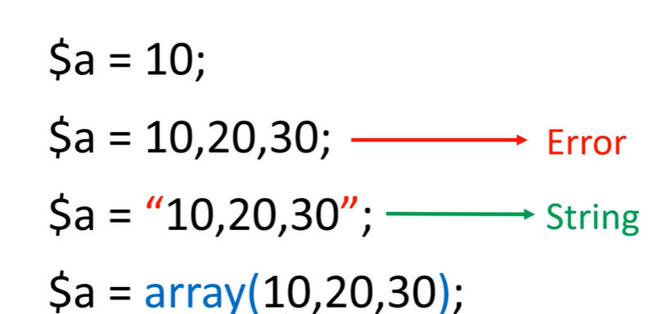
An array stores multiple values in one single variable:

Slide 3
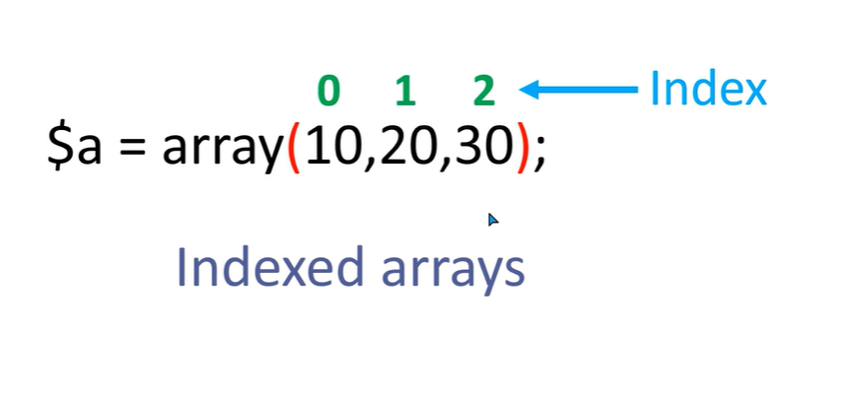

Slide 4
<?php
$colors=array("red","yellow","blue","green");
echo $colors[0]."<br>";
echo $colors[1];
echo $colors[2];
echo $colors[3];
?>

Slide 5
<?php
$colors=["red","yellow","blue","green"];
for($i=0;$i<4;$i++)
echo $colors[$i];
?>

Slide 6
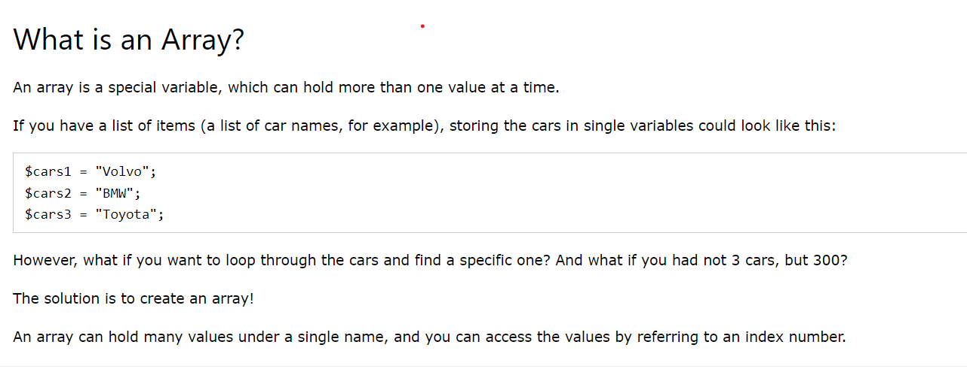
An array stores multiple values in one single variable:

Slide 7
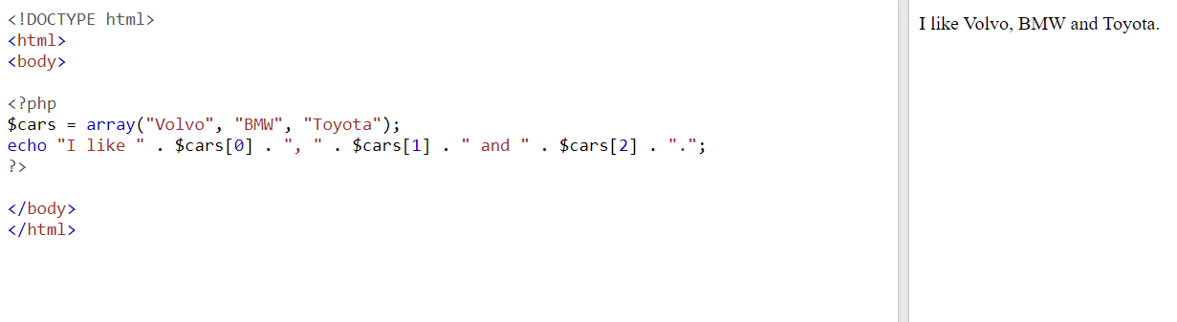

Slide 8
TRY THIS
$color = array('white', 'green', 'red'') Write a PHP script which will display the colors in the following way :
Output : white, green, red,
$color = array('white', 'green', 'red', 'blue', 'black');
Write a script which will display the following string
"The memory of that scene for me is like a frame of film forever frozen at that moment: the red carpet, the green lawn, the white house, the leaden sky. The new president and his first lady. - Richard M. Nixon" and the words 'red', 'green' and 'white' will come from $color.

Slide 9
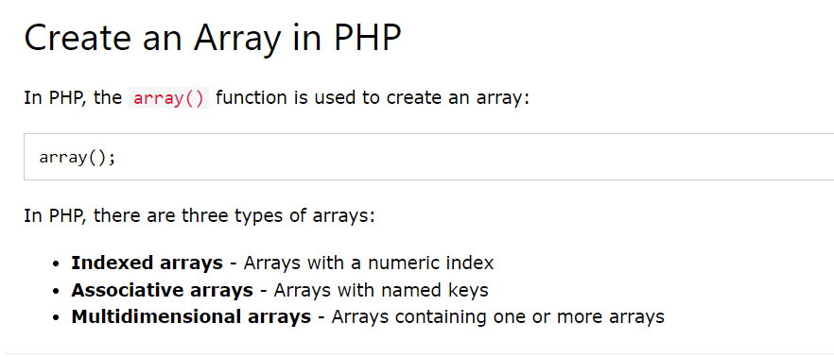

Slide 10
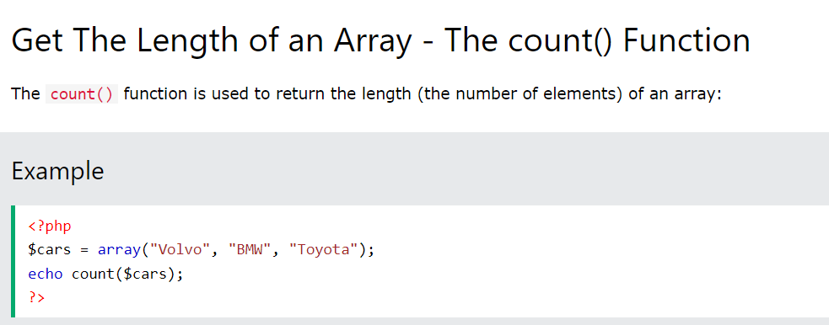

Slide 11
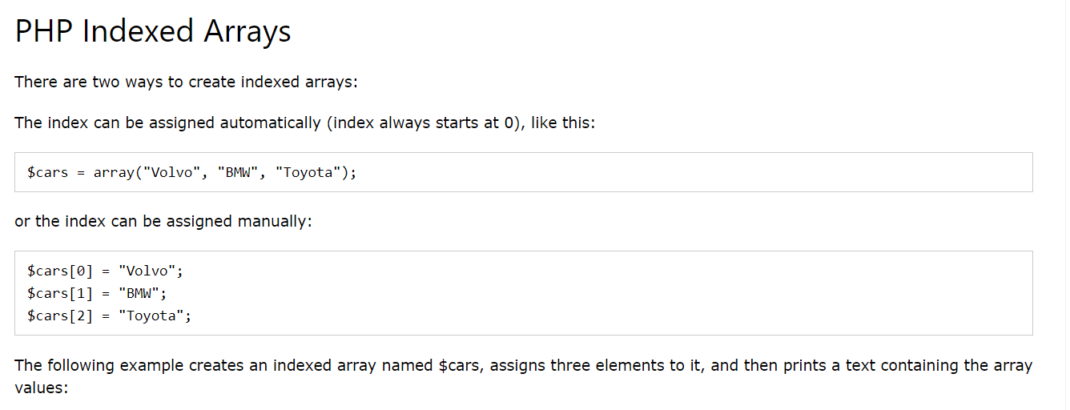

Slide 12
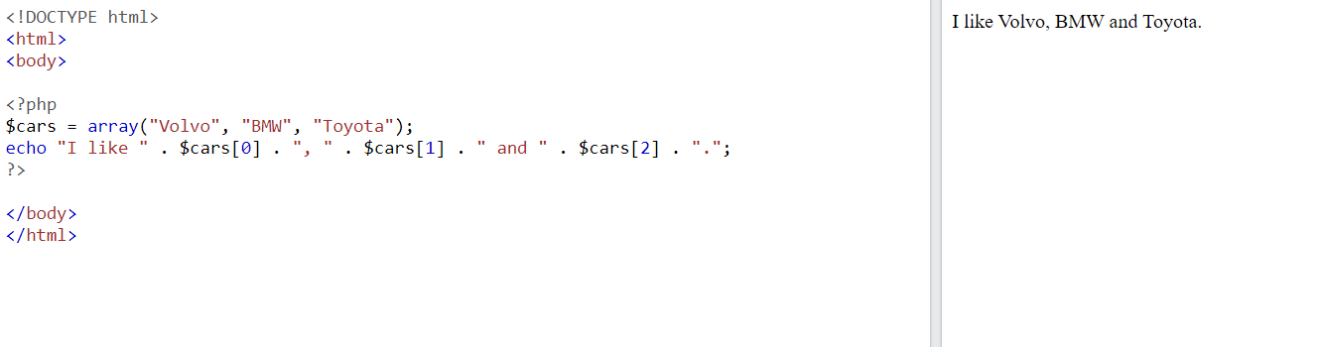

Slide 13
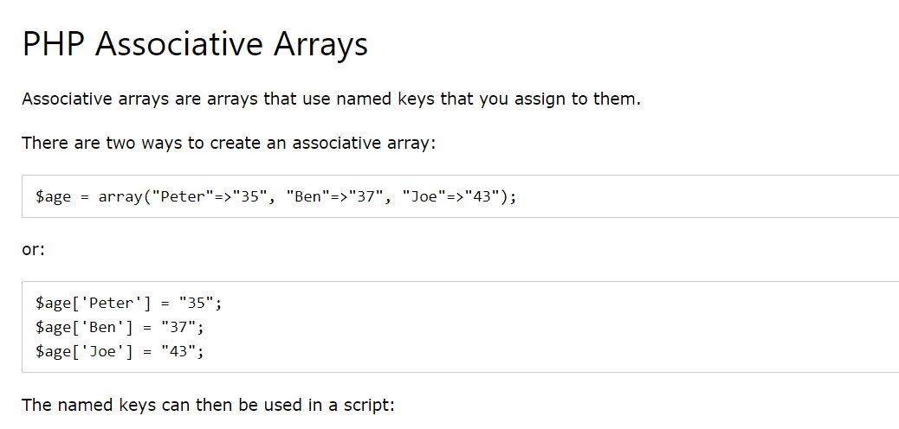

Slide 14
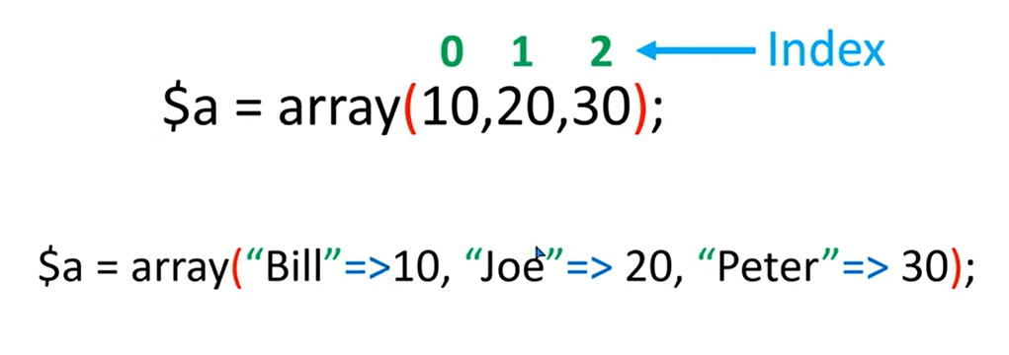
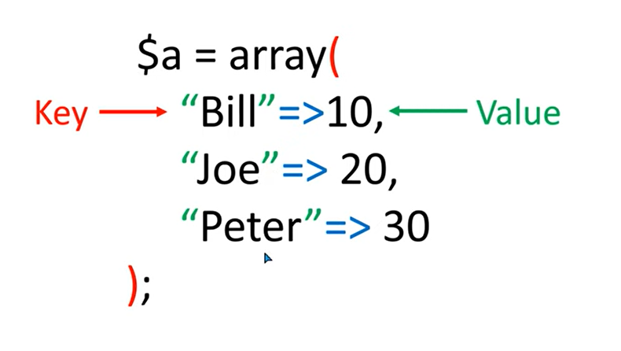
Associative Array

Slide 15
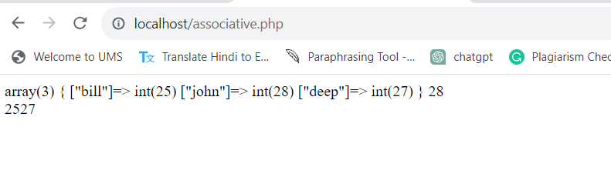
<?php
$age=array("bill"=>25, "john"=>28, "deep"=>27);
var_dump($age);
echo $age["john"]."<br>";
echo $age["bill"];
echo $age["deep"];
?>
Shows the data types of values

Slide 16
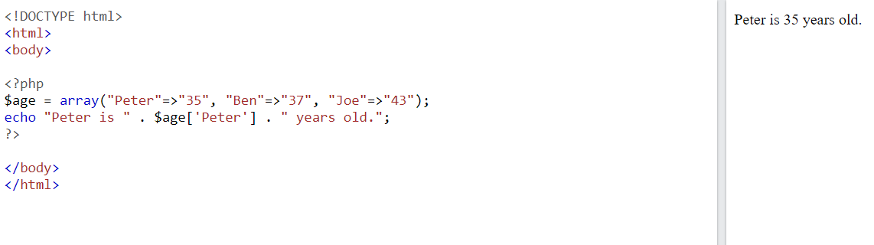

Slide 17
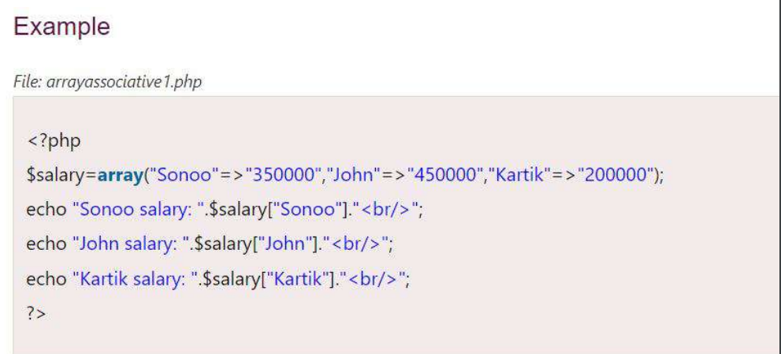

Slide 18
TRY THIS
Create an associative array representing a person's information, including name, age, and email.
Create an associative array of fruits and their corresponding colors. Loop through the array and print out each fruit and its color.

Slide 19
Loop Through an Associative Array
To loop through and print all the values of an associative array, you could use a foreach loop, like this:
<?php $age = array("Peter"=>"35", "Ben"=>"37", "Joe"=>"43"); foreach($age as $x => $x_value) { echo "Key=" . $x . ", Value=" . $x_value; echo "<br>"; } ?>
Key=Peter, Value=35 Key=Ben, Value=37 Key=Joe, Value=43

Slide 20
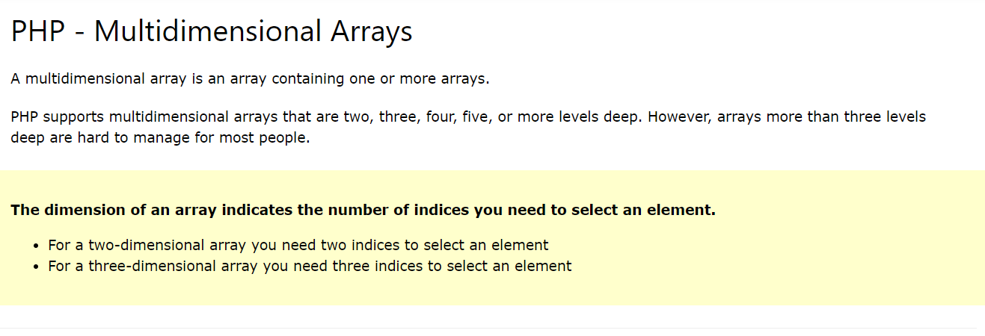

Slide 21
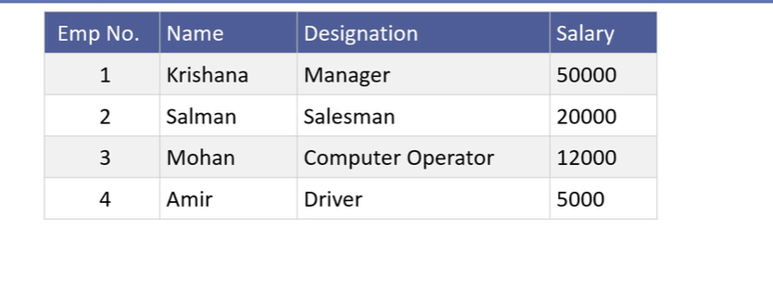
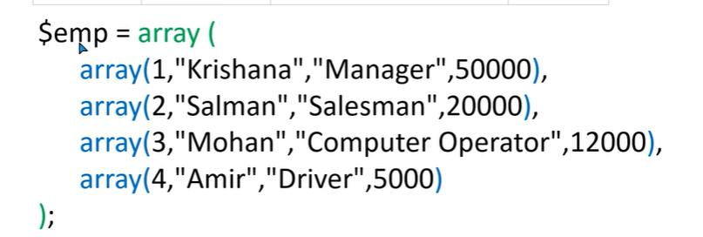

Slide 22
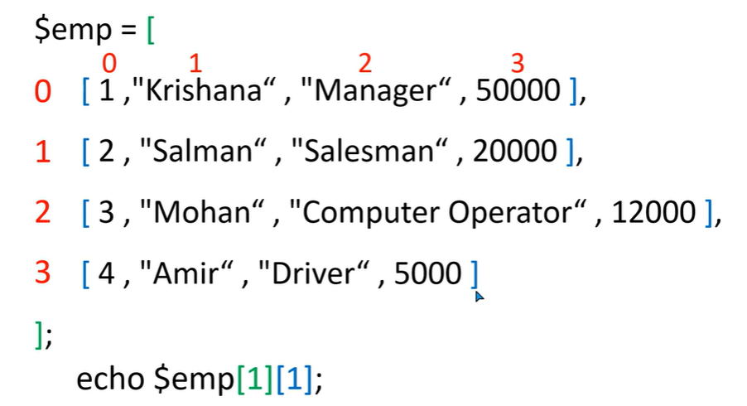

Slide 23
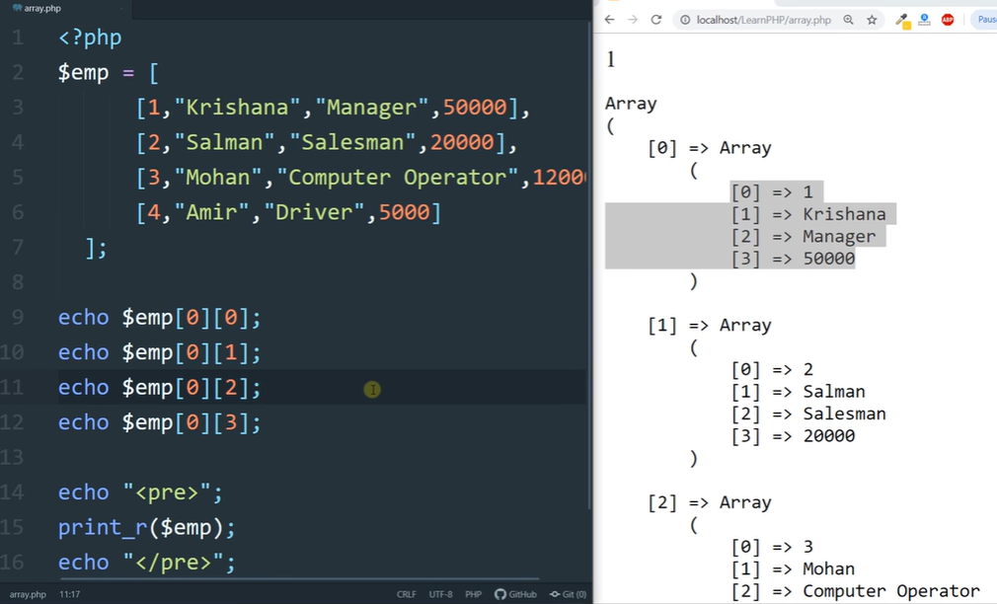

Slide 24
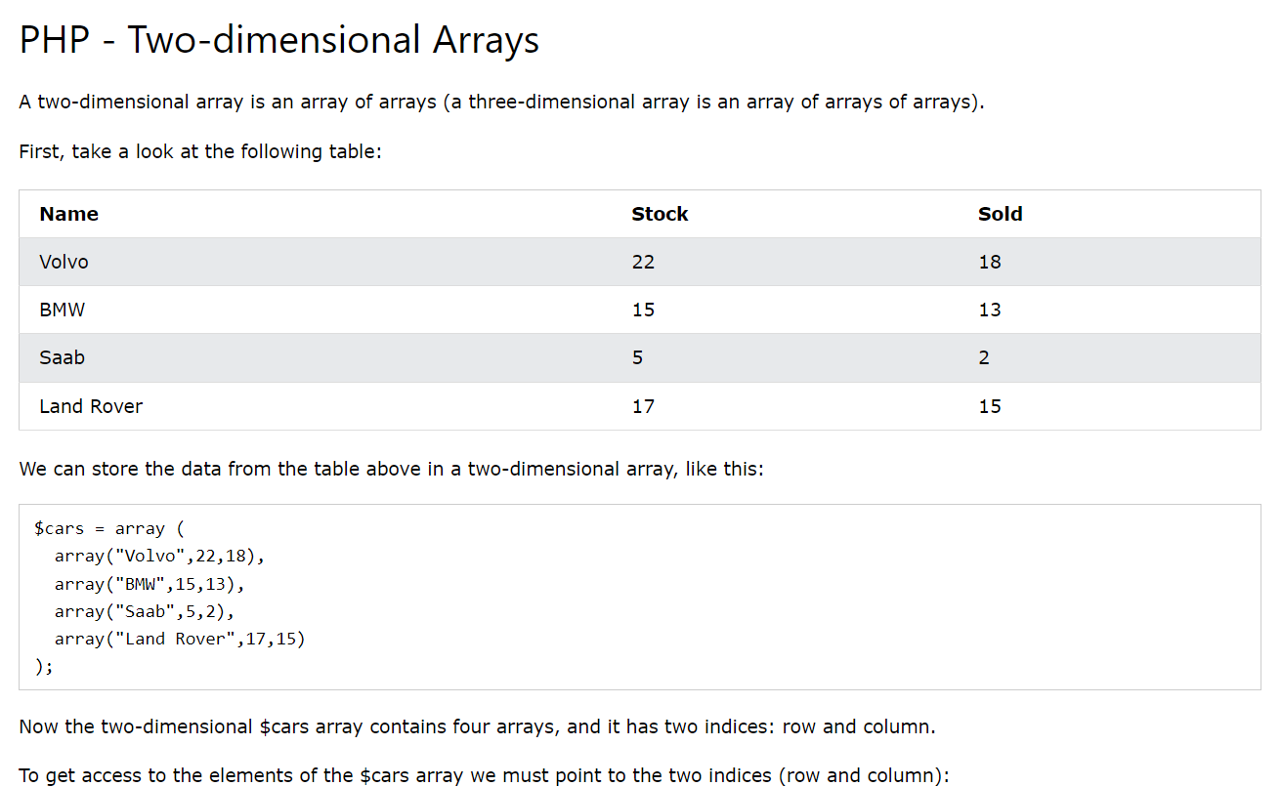

Slide 25
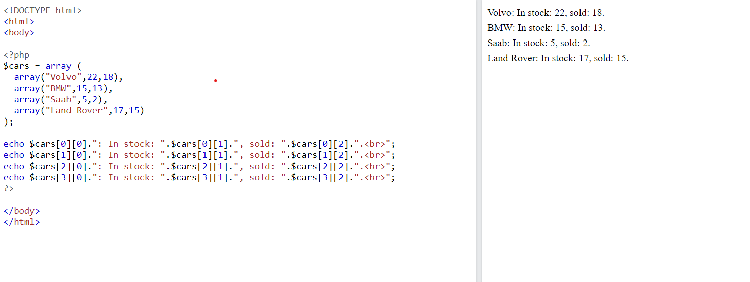

Slide 26
Write a PHP program to merge (by index) the following two arrays. Sample arrays : $array1 = array(array(77, 87), array(23, 45)); $array2 = array("w3resource", "com");
Expected Output :
Array ( [0] => Array
(
[0] => w3resource
[1] => 77
[2] => 87
)
[1] => Array
(
[0] => com
[1] => 23
[2] => 45
)
)

Slide 27
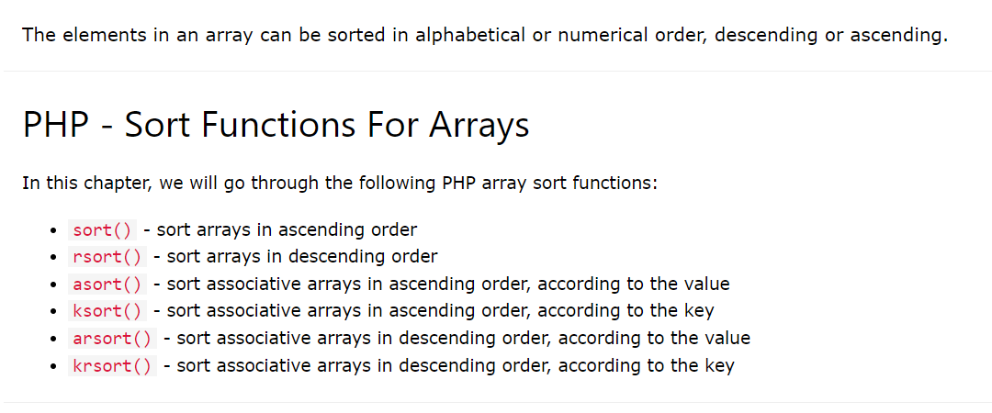

Slide 28
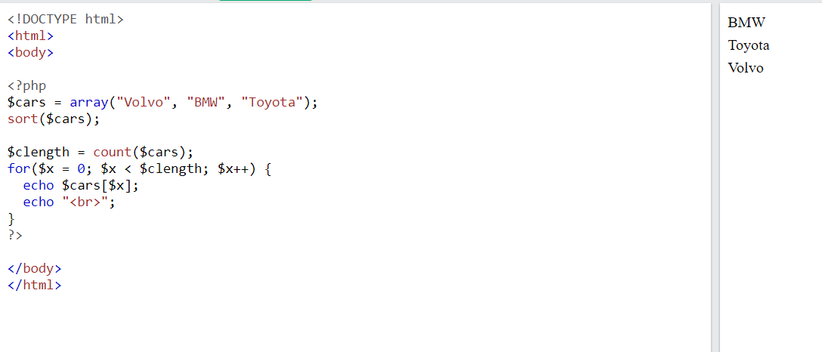
Sort Array in Ascending Order - sort()
The following example sorts the elements of the $cars array in ascending alphabetical order:

Slide 29
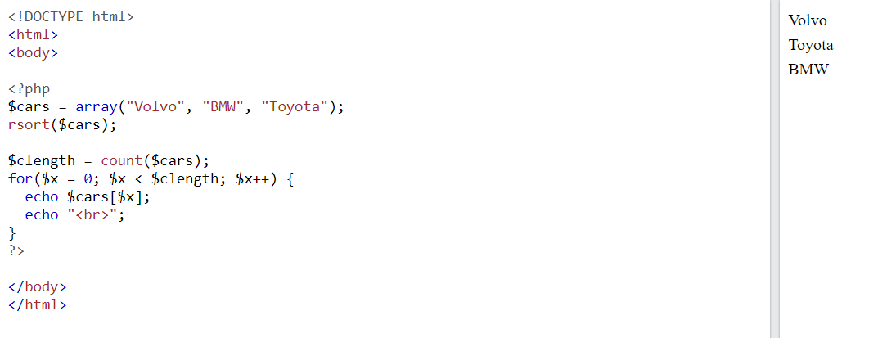
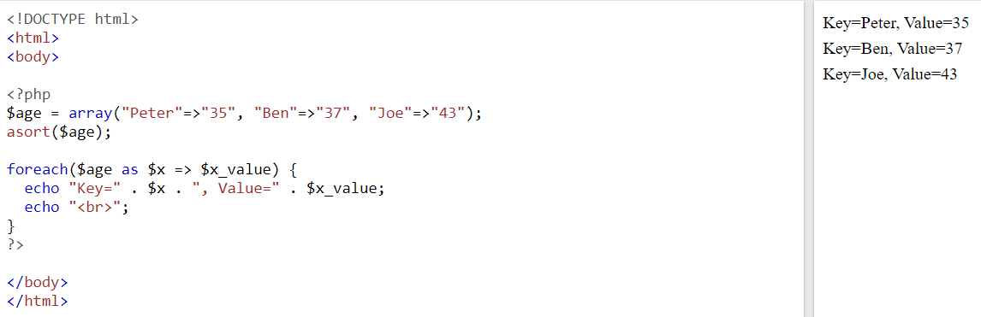
Sort Array in Descending Order - rsort()
Sort Array (Ascending Order), According to Value - asort()

Slide 30
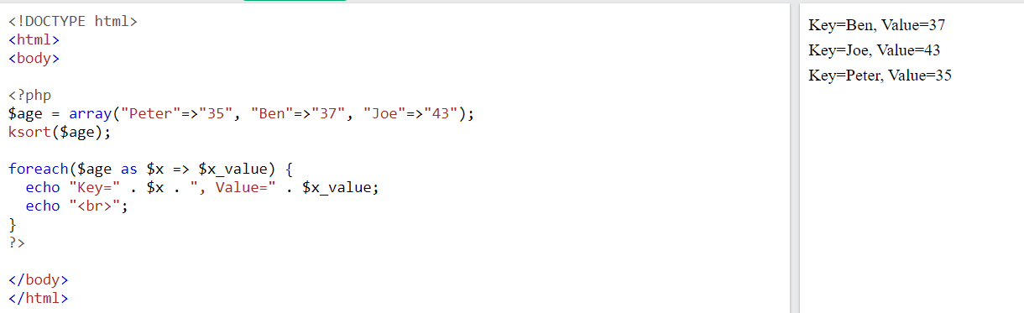
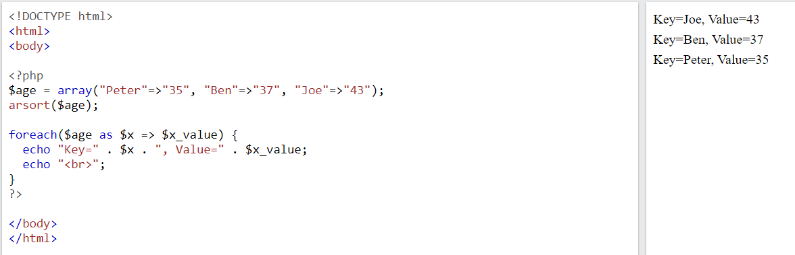
Sort Array (Ascending Order), According to Key - ksort()
Sort Array (Descending Order), According to Value - arsort()

Slide 31
TRY THIS
Write a PHP program to sort a multi-dimensional array set by a specific key.
Write a PHP function to sort an array according to another array acting as a priority list.
Write a PHP script to sort the following associative array : array("Sophia"=>"31","Jacob"=>"41","William"=>"39","Ramesh"=>"40") in
a) ascending order sort by value b) ascending order sort by Key c) descending order sorting by Value d) descending order sorting by Key

Slide 32
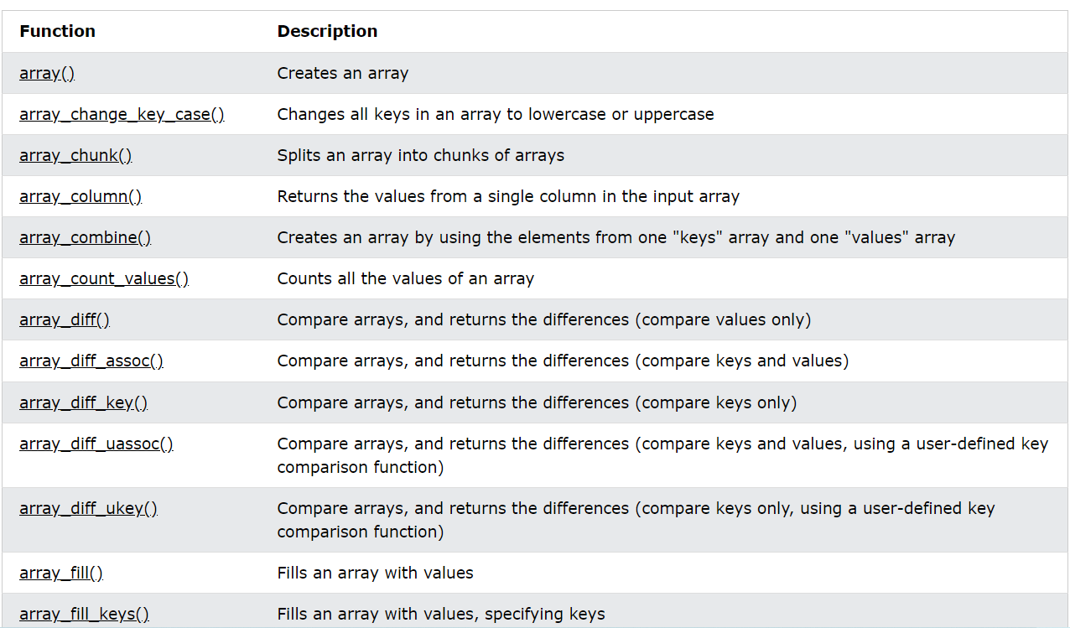
PHP Array Functions
The array functions allow you to access and manipulate arrays.

Slide 33
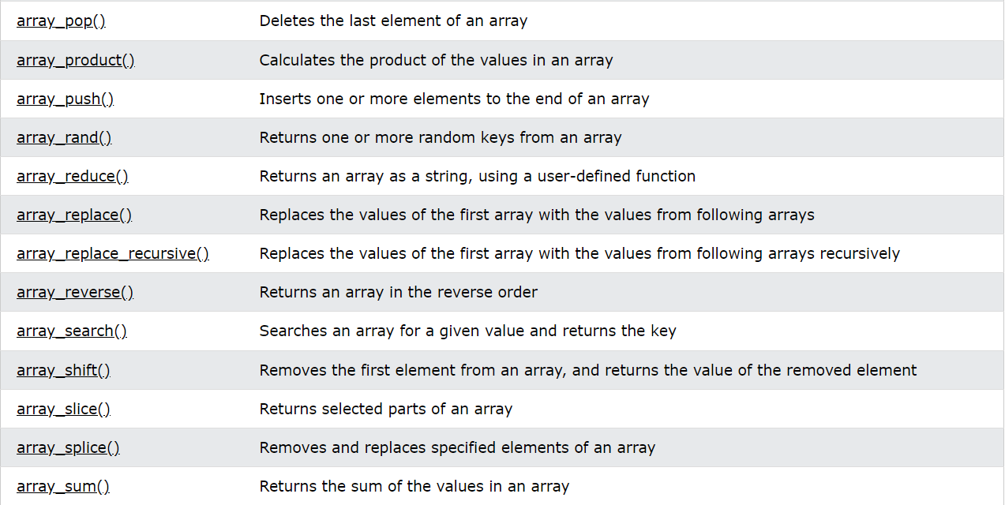
PHP Array Functions

Slide 34
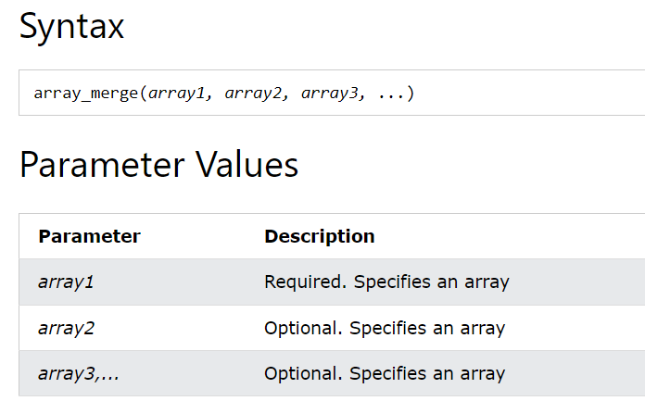
PHP array_merge() Function
The array_merge() function merges one or more arrays into one array.

Slide 35
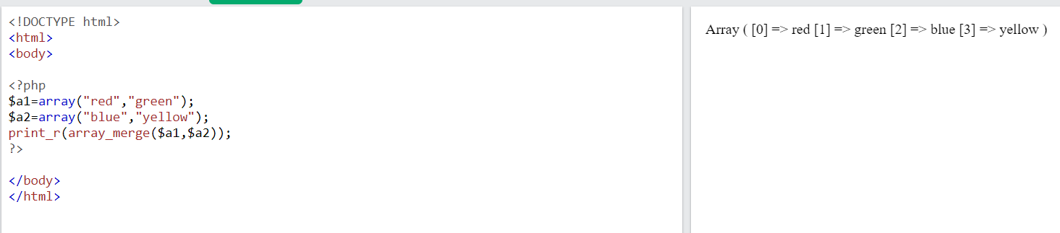

Slide 36
Traversing Arrays
Traverse an array means to access each element (item) stored in the array so that the data can be checked or used as part of a process.
To visit each and every element of an array is known as traversing array

Slide 37
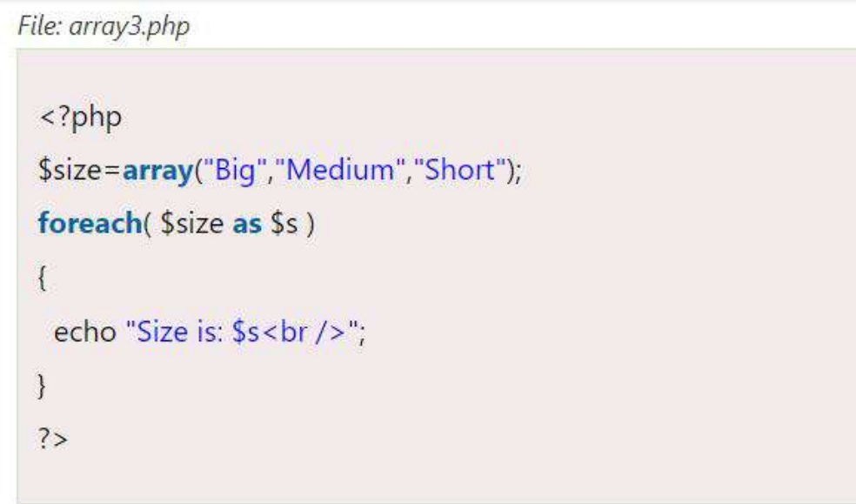

Slide 38
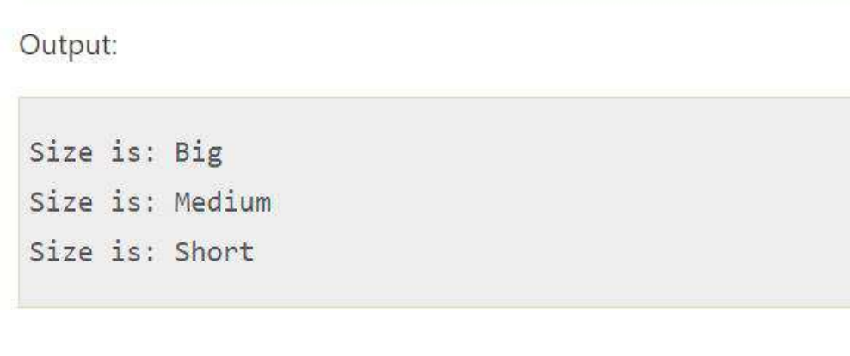

Slide 39
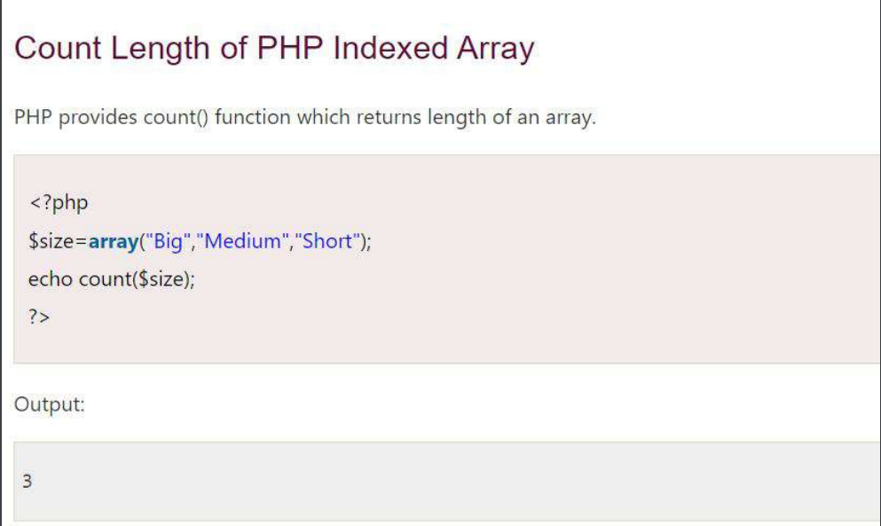

Slide 40
Which PHP function is used to add elements to the end of an array?
?
A) array_push()
B) array_pop()
C) array_shift()
D) array_unshift()

Slide 41
Which PHP function is used to add elements to the end of an array?
A) array_push()
B) array_pop()
C) array_shift()
D) array_unshift()

Slide 42
Which PHP function is used to combine two or more arrays into a single array?
A) array_merge()
B) array_combine()
C) array_union()
D) array_join()

Slide 43
Which PHP function is used to combine two or more arrays into a single array?
A) array_merge()
B) array_combine()
C) array_union()
D) array_join()

Slide 44
Which function is used to find the number of elements in an array in PHP?
A) count()
B) length()
C) size()
D) sizeof()

Slide 45
Which function is used to find the number of elements in an array in PHP?
A) count()
B) length()
C) size()
D) sizeof()

Slide 46
In PHP, how do you check if a specific element exists in an array?
A) element_exists()
B) in_array()
C) array_search()
D) find_element()

Slide 47
In PHP, how do you check if a specific element exists in an array?
A) element_exists()
B) in_array()
C) array_search()
D) find_element()

Slide 48
Which method is used to remove an element from the beginning of an array in PHP?
A) array_pop() B) array_shift() C) array_slice() D) array_splice()

Slide 49
Which method is used to remove an element from the beginning of an array in PHP?
A) array_pop() B) array_shift() C) array_slice() D) array_splice()

Slide 50
Which PHP function is used to remove duplicate values from an array?
A) array_unique()
B) array_distinct()
C) array_remove_duplicates()
D) array_filter()

Slide 51
Which PHP function is used to remove duplicate values from an array?
A) array_unique()
B) array_distinct()
C) array_remove_duplicates()
D) array_filter()

Slide 52
What does the array_keys() function in PHP return?
A) The values of an array
B) The keys of an array
C) The combined keys and values of an array
D) The sorted keys of an array

Slide 53
What does the array_keys() function in PHP return?
A) The values of an array
B) The keys of an array
C) The combined keys and values of an array
D) The sorted keys of an array

Slide 54
Which array function is used to extract a portion of an array?
A) array_extract()
B) array_slice()
C) array_subarray()
D) array_part()

Slide 55
Which array function is used to extract a portion of an array?
A) array_extract()
B) array_slice()
C) array_subarray()
D) array_part()

